Slide 1
Student Alcohol Consumption
By Mike Quach, Shivanshi Tiwari, Dylan Gordon, Dominick Kubica, Cole Novara

Slide 2
Introduction
The dataset we chose focuses on student alcohol consumption. This dataset comes from a study relating to the social, gender, and study information of students
It consists of two datasets: one regarding the math course and the other regarding the Portuguese language course, both in high school
These datasets contain several attributes related to the students' academic and personal lives, including weekly alcohol consumption, social and family relationships, and school performance
With 33 attributes for each student, the datasets offer a comprehensive view of the students' habits and their potential impact on school performance
Our analysis aims to uncover insights into how these variables correlate and to what extent alcohol consumption among students affects their academic success

Slide 3
Data Cleaning
To begin, we cleaned the data. We used null_values_check to identify the percentage of null values in each column
We use the isnull() method chained with sum() to get a count of the nulls for each column and then divide by the total number of rows to find the percentage, which informs us about the extent of missing data
The output of this function revealed that several columns related to grades over the years (labeled G1, G2, and G3) had a significant percentage of missing values
To tackle the missing values, we used the fillna() method with the student.mode().iloc[0] as the argument
This fills in missing values with the most frequently occurring value in each column
We confirmed that this worked by checking the sum of nulls again, which returned zero for all columns, proving a dataset with no missing entries

Slide 4
Data Cleaning (cont.)
The df.info() function shows that all our columns were correctly filled and that no null types remained and the df.describe() function provides a statistical summary of all numerical columns
We then examined specific columns with the df[['column_names']] syntax to focus on the data we are most interested in
Finally, we dropped unnecessary columns and renamed others for clarity.
For example, we dropped the 'G1_x', 'G1_y', 'G2_x', 'G2_y', 'absences_y’, 'failures_y’, 'paid_y', and 'school' columns because they were not needed for our analysis or because we created dummy variables for them
We then renamed certain columns like 'failures_x' to 'failures', 'paid_x' to 'paid', and so on, to make them more intuitive

Slide 5
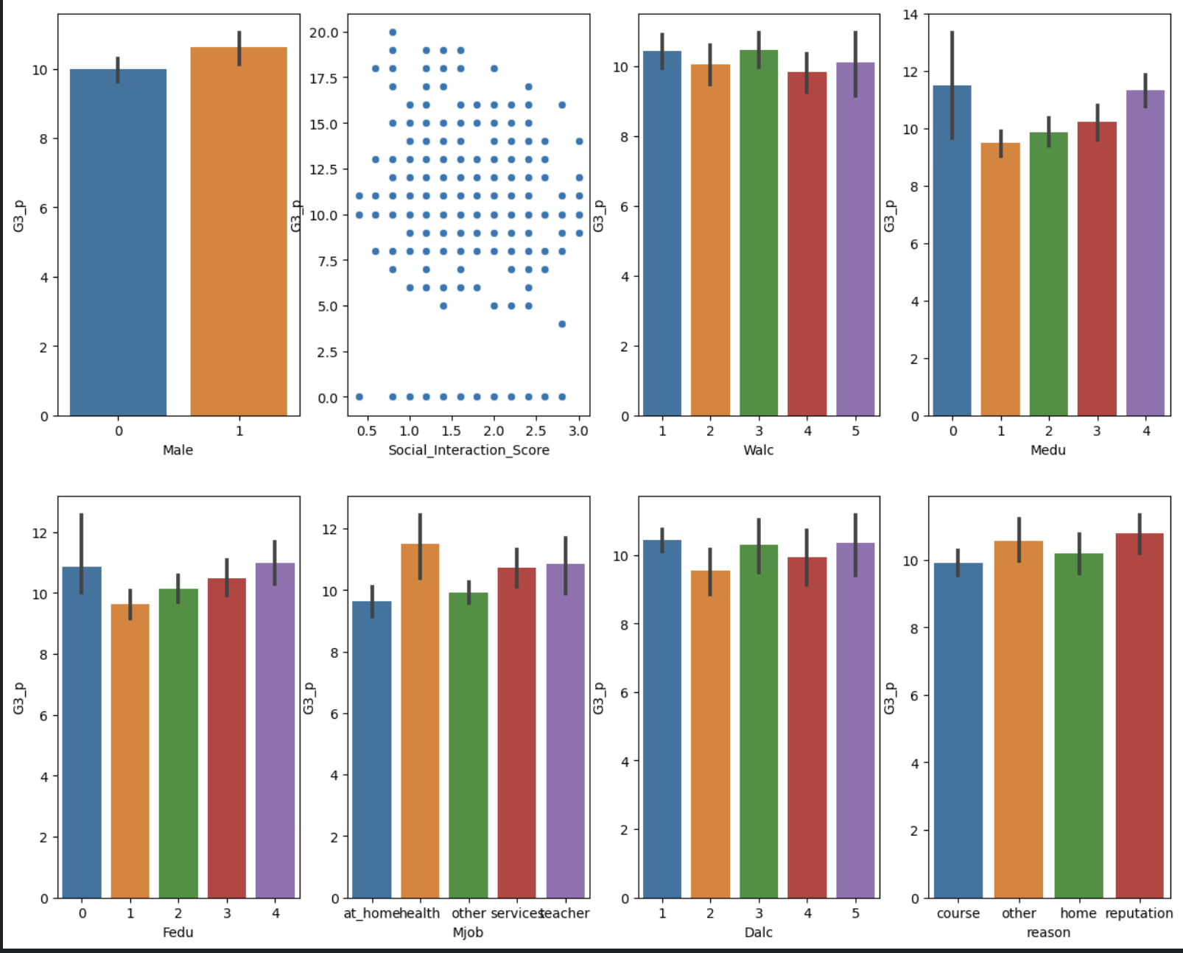
We calculate the Social Interaction Score by considering three key elements: romantic involvement (binary; +1 if in a relationship), free time after school (scored from 0 to 1, in 0.2 increments, based on a scale of 1-5), and the frequency of going out with friends (also scored from 0 to 1 in 0.2 increments). By aggregating these factors, we create a comprehensive measure of each student's social engagement, offering insights into how social dynamics might correlate with academic and personal outcomes.

Slide 6
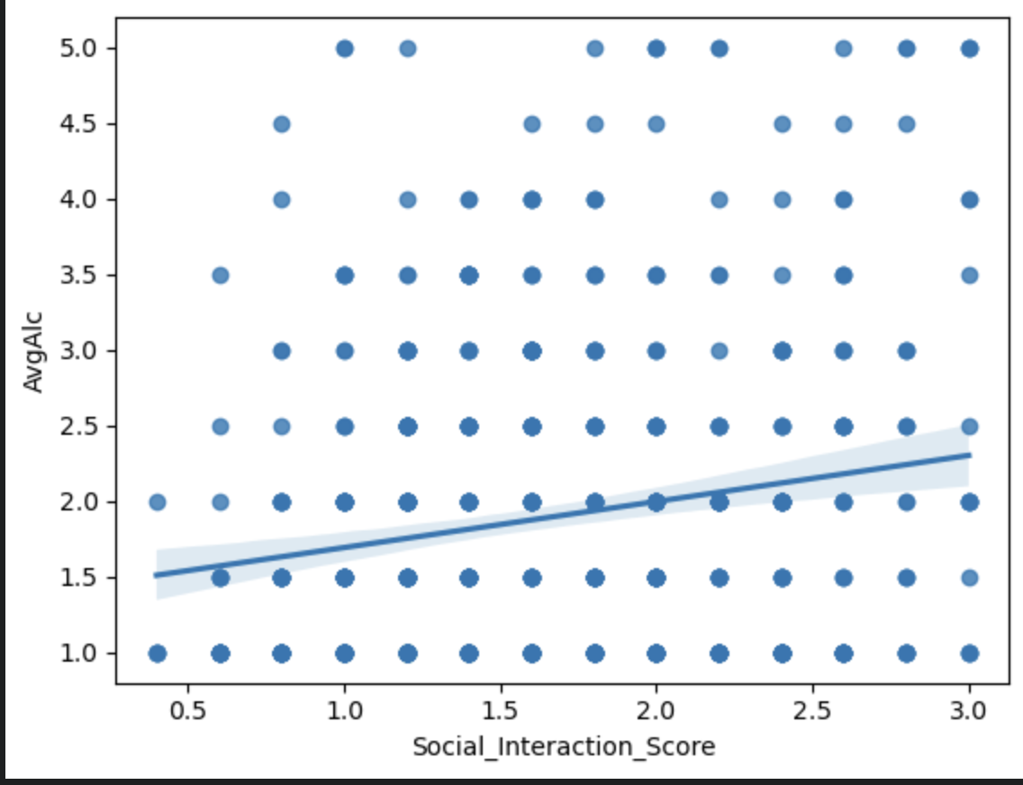
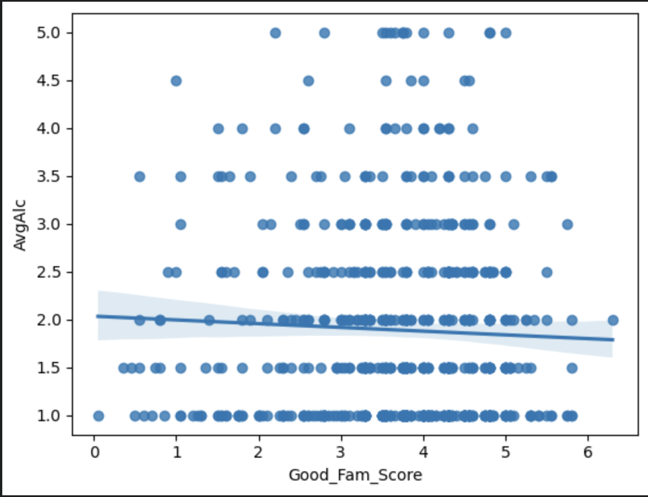
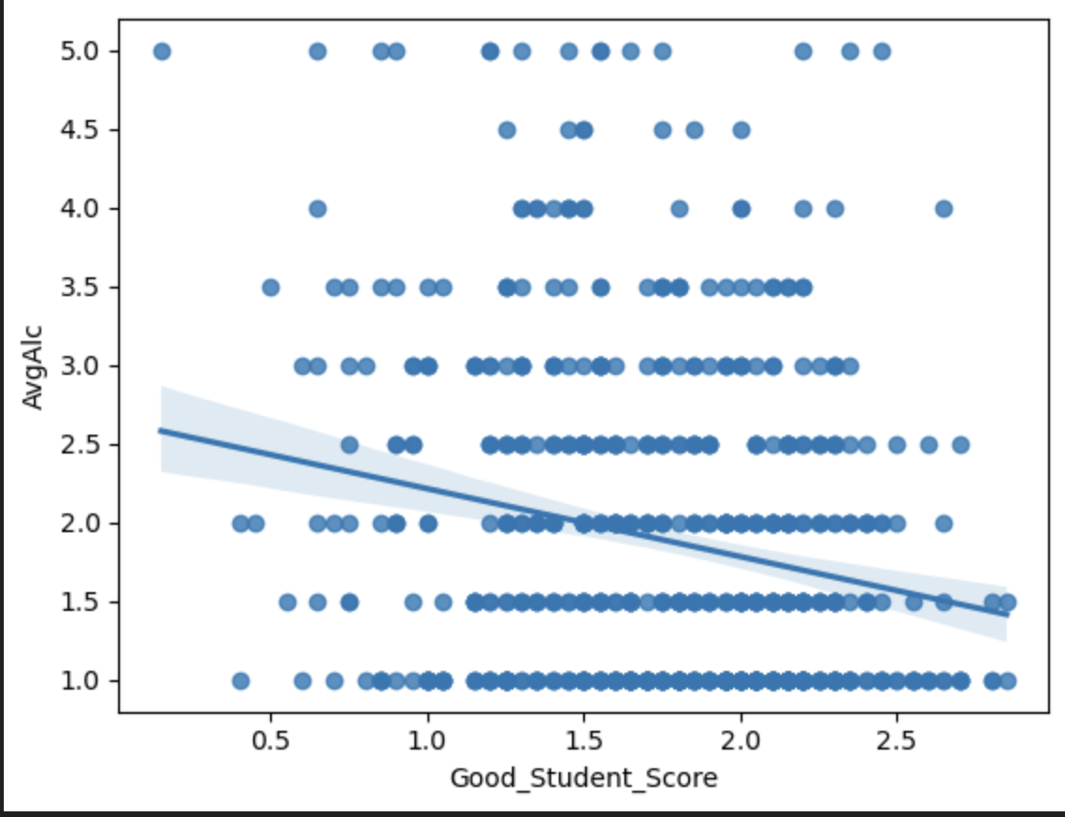
Our Approach
We approached trying to find correlations between our different data points first through making 3 new columns where we attempted to find correlations in some areas we thought would be the most probable impact on a students performance:
Good Student Score
Social Interaction Score
Good Family Score

Slide 7
Our Approach Cont.
Good Student Score: This part focuses on quantifying students' academic success. The Good Student Score is formulated by incorporating final grades (with every 1/20th increment adding +0.05 to the score), attendance (where absences lead to deductions, with each quartile reducing the score by 0.25), and the incidence of failing grades (no fails contribute a full point, while each fail deducts 0.25 points). This metric is designed to investigate the correlation between academic achievements and other variables like social activities or family background.
Good Family Score: In this section, we explore the influence of family dynamics on student life. The Good Family Metric considers several aspects: average parental education level (scored from 0 to 1), family size (binary; 1 for families with ≤3 members, 0 for >3), quality of family relationships (scored like free time and going out with friends, from 0 to 1), and parent cohabitation status (1 for living together, -1 for living apart). Additionally, whether a parent has a job at home is factored in (+1 for at-home jobs, -1 otherwise). This comprehensive approach aims to highlight how various aspects of family life might affect students' academic and social experiences.

Slide 8
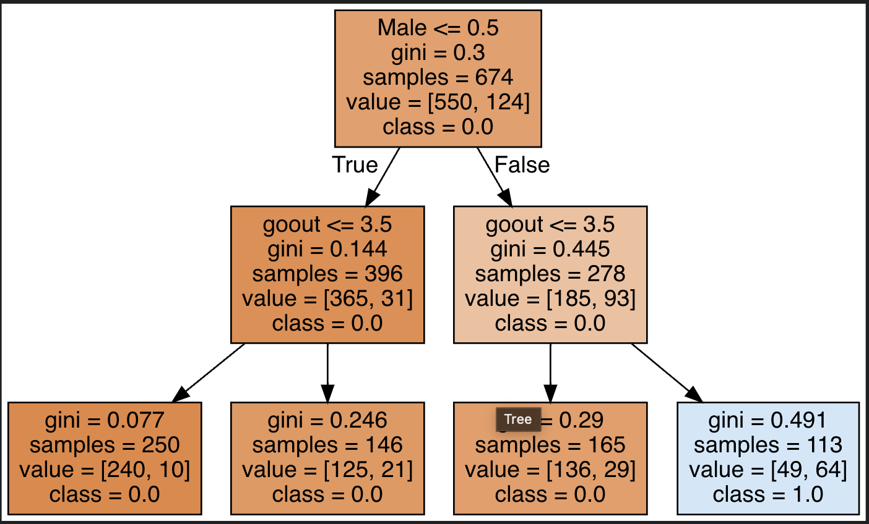
Our Machine Learning Tree
Decision tree classifier is based on the column called AvgAlc that was made binary
The value classes on the second row of the tree show our second major analysis point. The values sections show there is a higher proportion of males who self identify as being a heavy drinker.
The proportion of 93/278 = 0.33 is much higher than 31/396 = 0.07, showing that high school males identify as drinking more than their female counterparts.

Slide 9
Logistic Regression
Model -1 (with all variables)
Here we have run a Logistic regression model and after running regression on train and test data we can see that:
r^2 = 1 which suggest overfitting
Adj R^2 = 1 The independent variables might be perfectly linearly related, causing numerical instability or making it impossible to estimate the coefficients properly. It also indicate a data error, such as duplicated records, incorrect transformations, or a perfect relationship due to some mistake in the dataset.
The Coefficients of the variables and their VIF (variance inflation score: is a measure of the amount of multicollinearity in regression analysis) are very small which indicates the problem of “Multicollinearity”

Slide 10
Logistic Regression (cont.)
Model - 2 (With significant variables (Mentioned) )
R^2 - explains that almost 67% of the variation in the data is explained by this model
Several variables have p-values higher than 0.05, suggesting they might not significantly influence the outcome. A low p-value (typically < 0.05) suggests that the predictor variable is statistically significant.
Any VIF score greater than 6 is considered indicative of high multicollinearity, here Social_Interaction_Score, goout, age, studytime and health have high multicollinearity.
For the next model, we tried regression with no high multicollinear variables, hence we removed Social_Interaction_Score, goout, age, studytime and health from the data.

Slide 11
Logistic Regression (cont.)
Model - 3 (with moderate collinear variables)
This model explains 66% of the variance of dependant variable (final scores) is explained by the independent variables, with moderate multicollinearity.
Insight :: Both Daily alc consumption and Weekly alc consumption are extremely close to 0 indicating that they have minimal effects on the prediction of marks of a student.
IMPORTANT: These coefficient suggests a lack of relationship between daily/weekly consumption and student marks but it doesn’t necessarily means that there is no impact of alcohol consumption on a student’s final marks, other qualitative factor might be at play here.

Slide 12
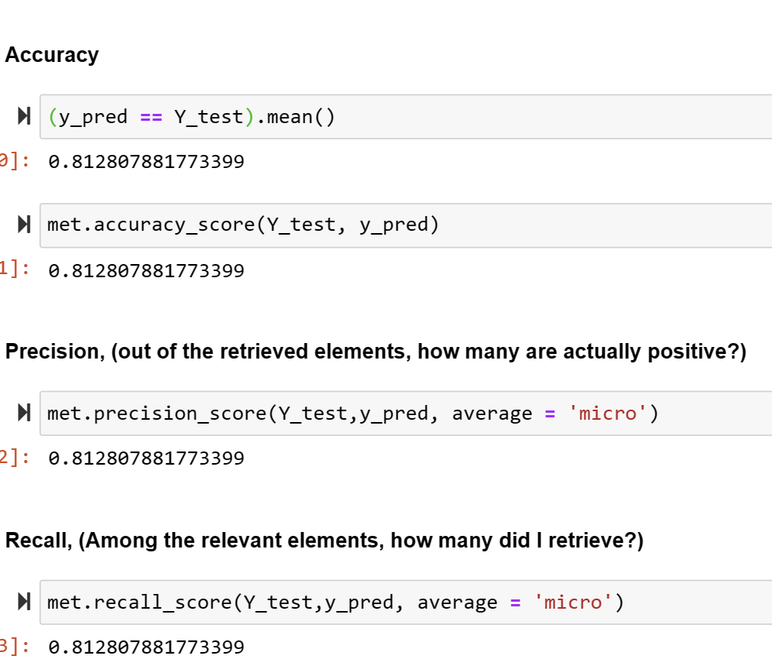
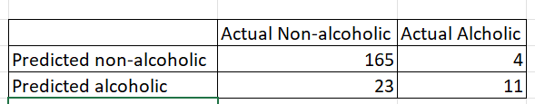
Categorization Machine Learning

Slide 13
Managerial insights
Concerned High School administration should take away some key insights from our analyses:
1) For reducing alcohol abuse in students, propaganda / ads should focus on sober benefits such as reducing attendance rather than student grades.
2) Since the incidence of high school boys perceiving themselves as being heavy drinkers is 4x more than their female counterparts, marketing for anti-alcohol abuse programs should be male-centric and be displayed in male spaces. This could mean more male bathroom flyers, or coaches talking with male sports teams at school.

Slide 14
Thank You!

